Slide 1

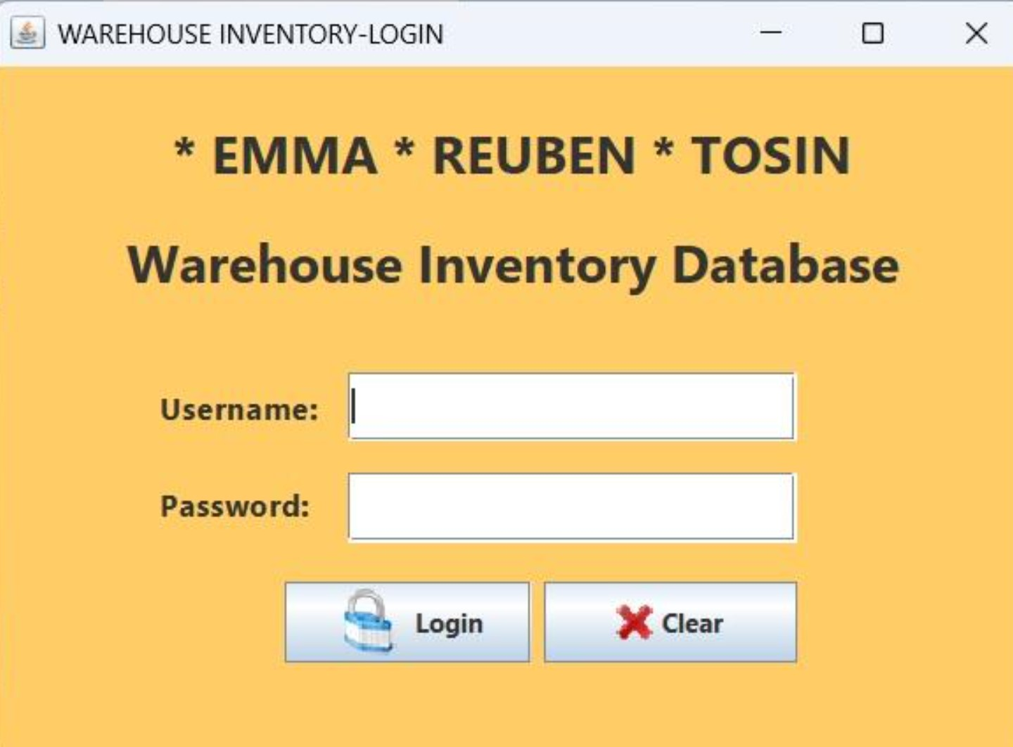
A COMPREHENSIVE WAREHOUSE MANAGEMENT
SYSTEM

Slide 2
CORE FUNCTION
This application is designed to streamline operations and enhance efficiency digital transformation solution for modern warehouse needs, real-time tracking and management capabilities (Inventory)

Slide 3
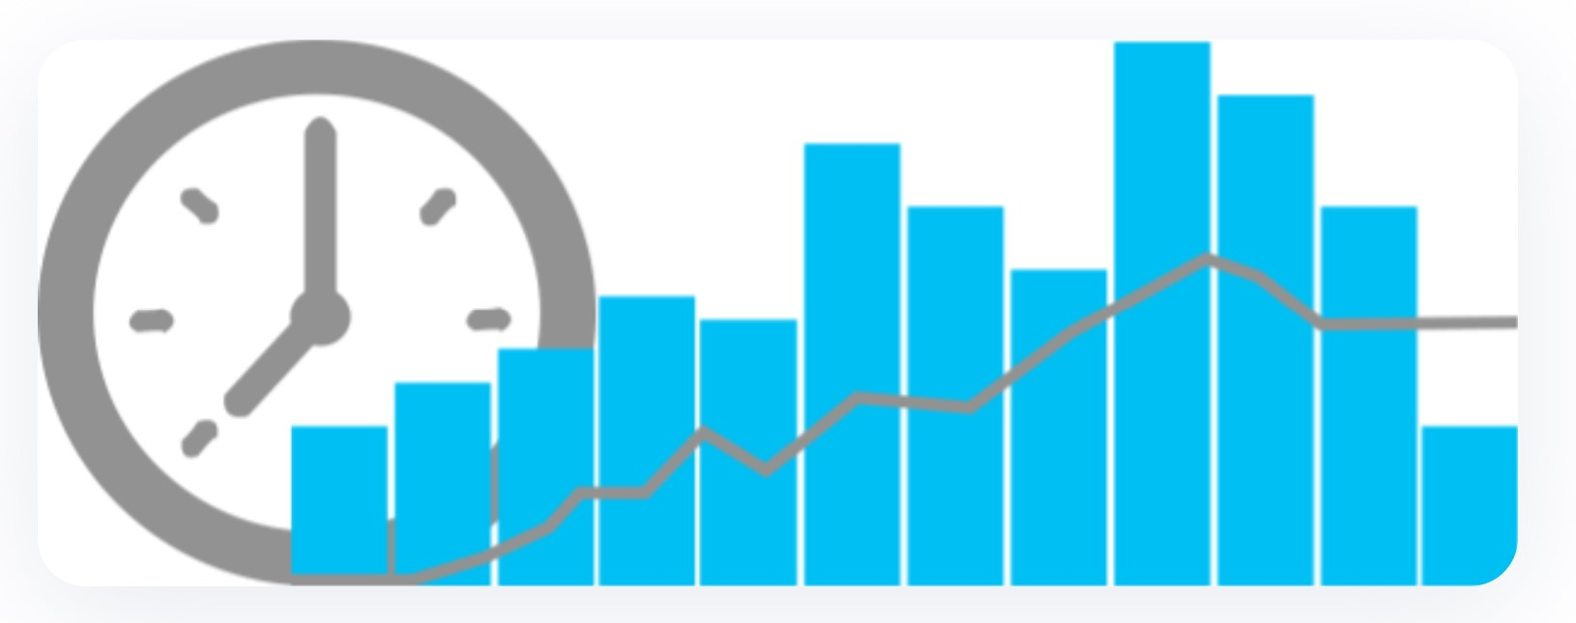

Key Features
Real-time inventory tracking
• Automated stock level alerts
• Batch and serial number tracking
• Multiple location management
• Expiry date monitoring

Slide 4

Analytics & Reporting
  custom report generation
  performance metrics
  inventory forecasting
  cost analysis
  real-time dashboards

Slide 5
Storage Management
Dyanmic BIN Allocation
ZoneManagement
Space optimization
Temperature Monitoring
Stock Rotation

Slide 6
System Users
Warehouse Manager
System Administrator
Picking and packing operator
Forklift operator
Material Handlers
Put away operators

Slide 7
Management Team
Warehouse Supervisors
Staff coordination
Performance monitoring
Resource allocation
Inventory management
Stock level management
Reorder planning
Inventory optimization

Slide 8
Support Team
IT Support
System Maintenance
User access management

Slide 9
Implementation Benefit
Improved inventory accuracy
Reduced operational cost
Enhanced Productivity
Enhanced Productivity
Better space utilization
Real time visibility
Data driven decision making

Slide 10
Tools Used
Apache Net Beans
MySQL Workbench
Docker
Visual Paradigm
OpenAI

Slide 11
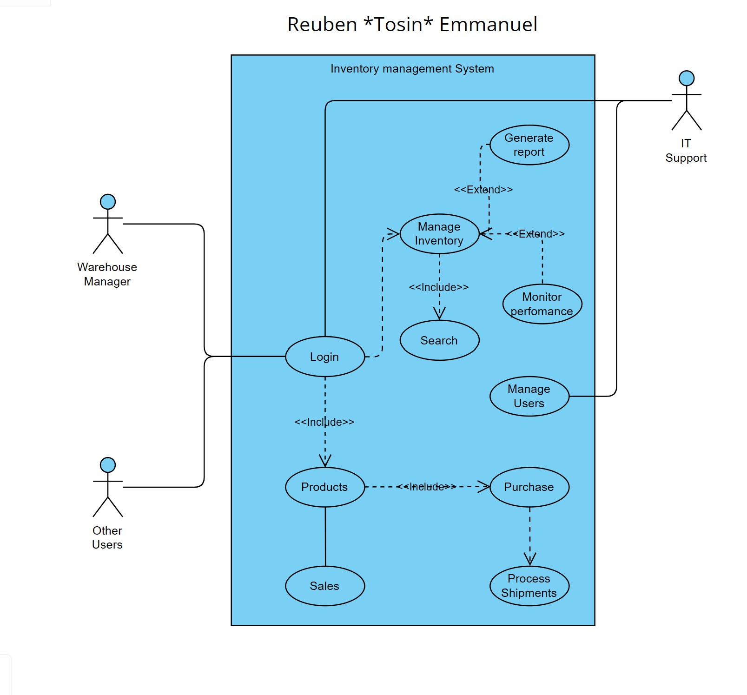
Use Case Diagram

Slide 12
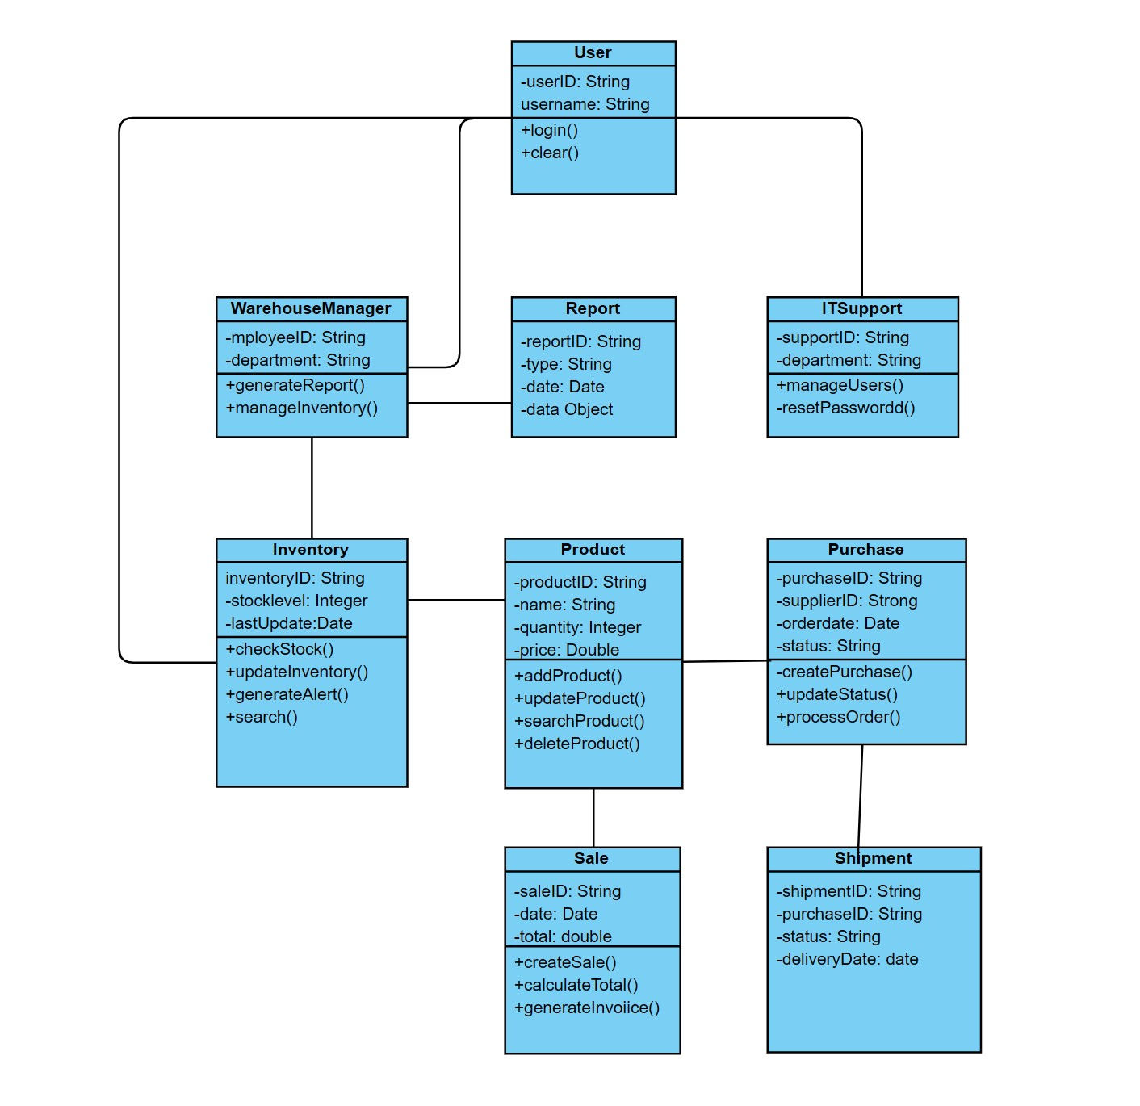
Class Diagram

Slide 13
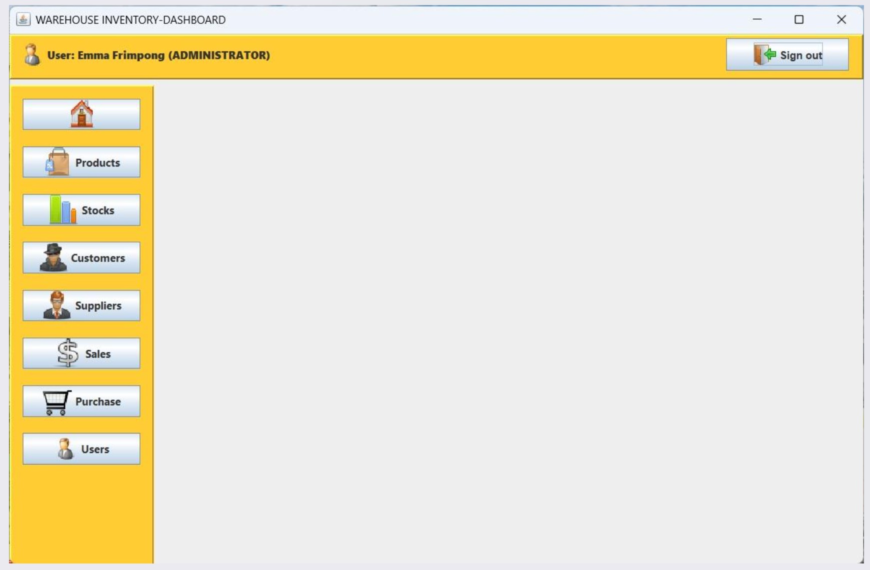
Performance Shots

Slide 14
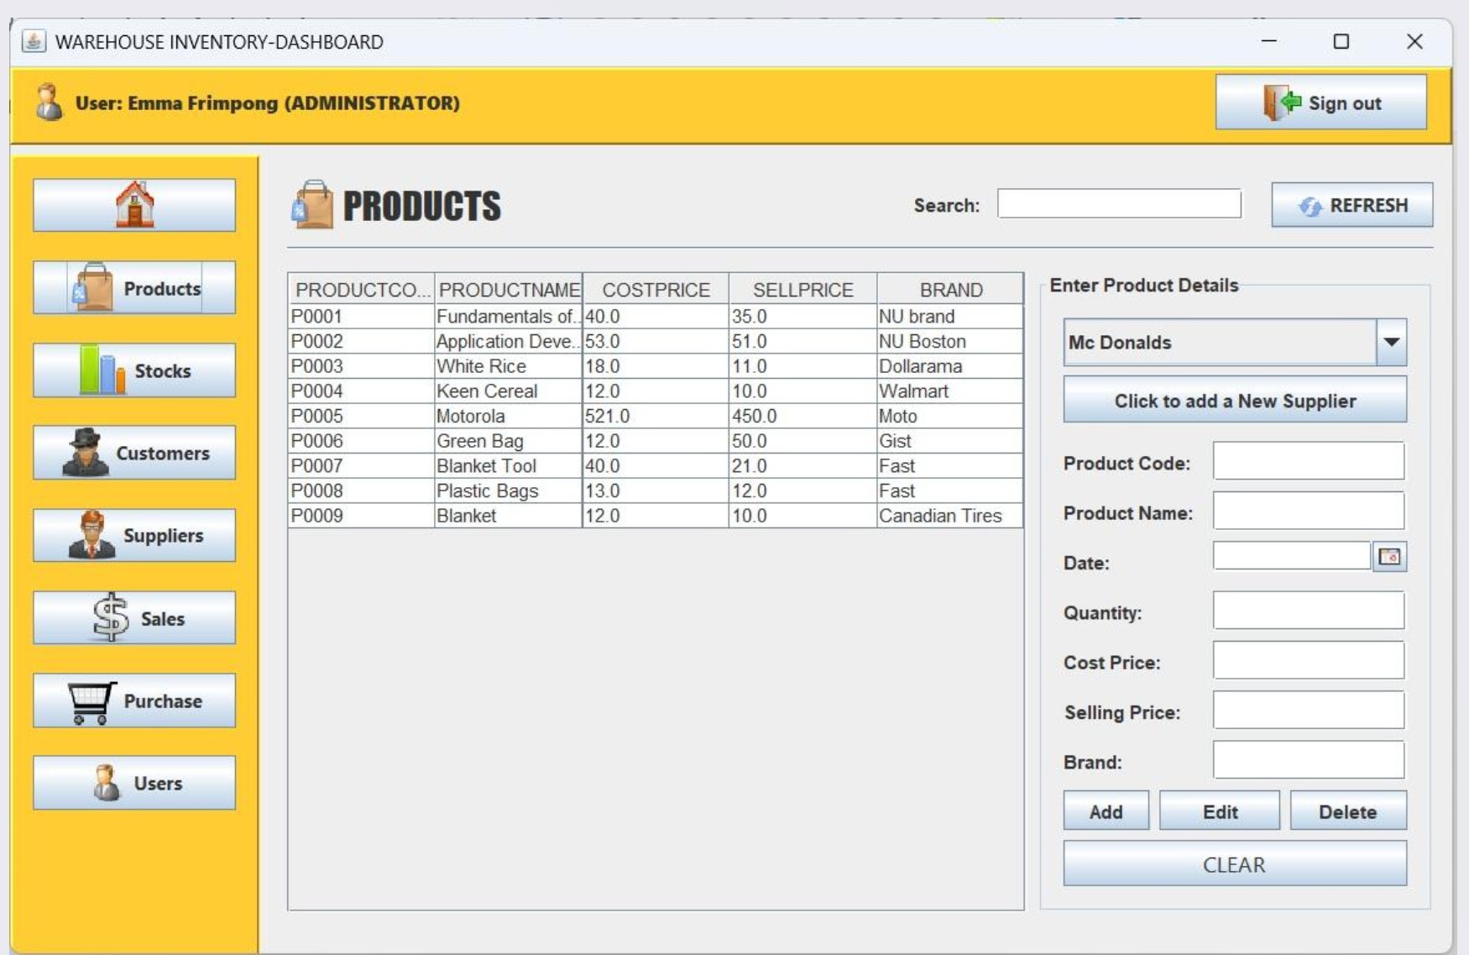
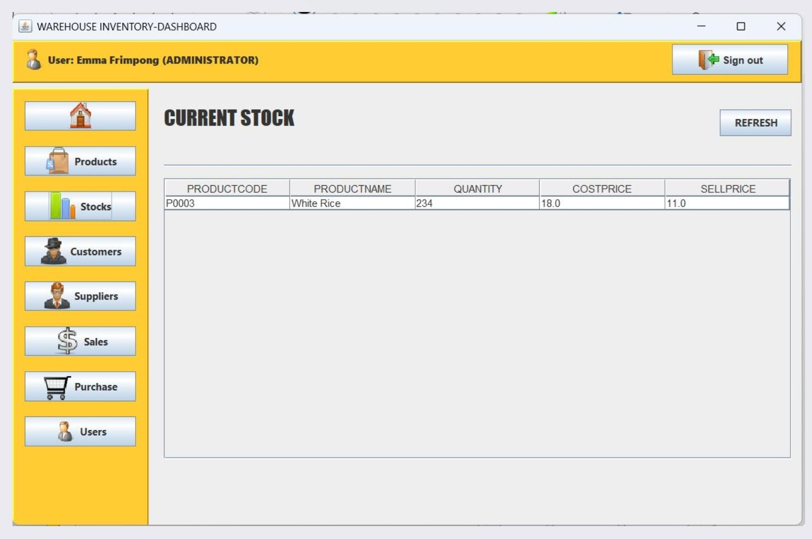
THANK YOU

